Slide 1
ETL System for Sales, Customer, Product & Inventory Management (Using SSIS)

Slide 2

Problem Statement
The organization requires an automated ETL system to process daily CSV files.
Current issues include:
Manual and error-prone data handling
No historical tracking of changes
Inconsistent inventory tracking
Lack of logging
Limited support for analytics and reporting

Slide 3
Objectives
✔ Build an SSIS-based ETL solution for automated daily data loading
✔ Implement CDC or SCD Type 2 for Customer & Product dimension tracking
✔ Implement incremental loads for sales data
✔ Generate daily inventory metrics (BOH, EOH)
✔ Detailed ETL logging

Slide 4

Tools & Technologies
ETL Tools
Microsoft SQL Server Integration Services (SSIS)
Database Technologies
Microsoft SQL Server (SQL Queries, Stored Procedures, Functions)
SCD Type 2 Implementation
CDC (Change Data Capture) or Merge Logic
Other Technologies
CSV file processing
Control Flow and Data Flow tasks
Event Handlers for logging

Slide 5
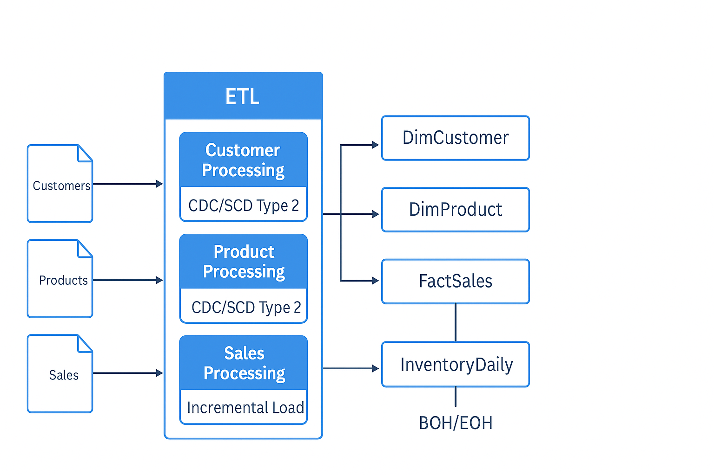
System Architecture
CSV Source Files
• Daily input: Customers, Products, Sales
• Stored in a configurable file directory
Staging Layer
• stg_customers, stg_products, stg_sales
• Raw data loaded from CSV
• Basic validation and structure alignment

Slide 6
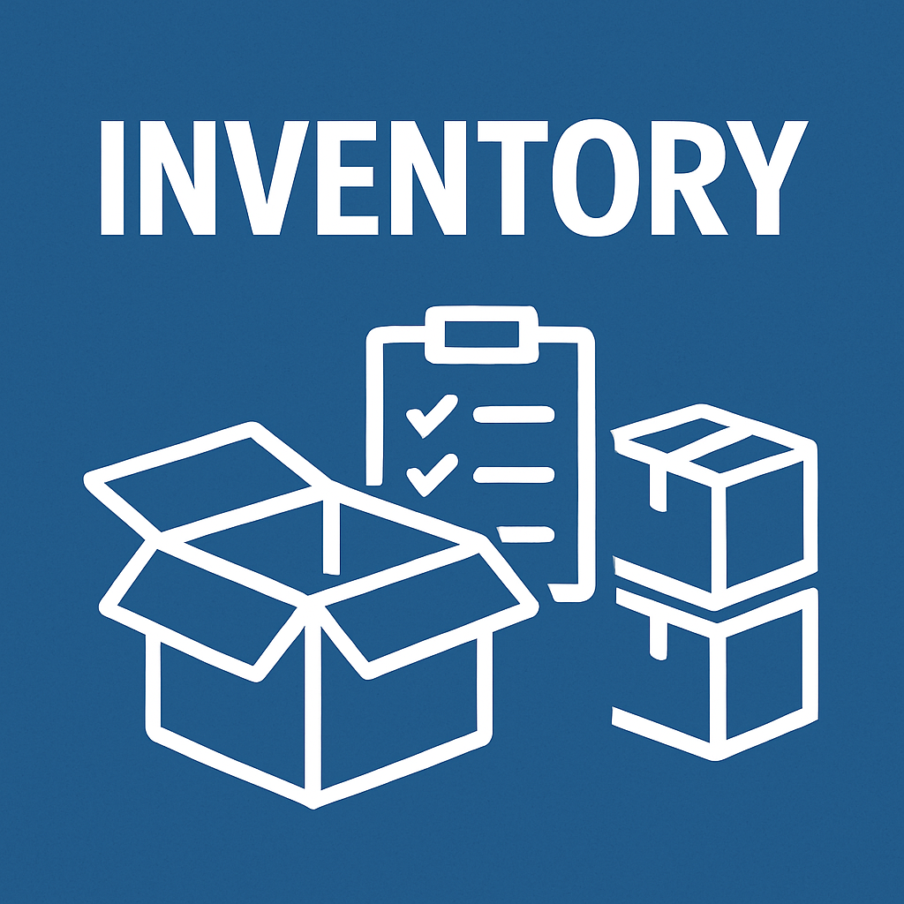
Transformation Layer (SSIS)
• Customer Processing – SCD2 logic for historical tracking
• Product Processing – SCD2 logic applied
• Sales Processing – Incremental load
• USD → NPR currency conversion
• Inventory update using BOH/EOH logic
Data Warehouse Layer
• Dim_Customers (SCD2)
• Dim_Products (SCD2)
• Fact_Sales (Incremental)
• InventoryDaily (BOH/EOH updates)

Slide 7

Audit & Logging Layer
• ETL_Audit table captures:
• Start time
• End time
• Status (Success/Failure)
• Error description

Slide 8

Implementation Details
Customer & Product Loads (CDC + SCD2):
• Read daily CSV
• Apply CDC/SCD Type 2 logic
Tracks:
Inserts
b) Updates
c) Deletes (IsActive = 0, EndDate = load date)
Sales Load (Incremental):
• Loads only new records
• Converts Amount_USD → Amount_NPR

Slide 9

Inventory Calculation:
• BOH = previous day’s EOH
• EOH = BOH − QtySold
Logging & Error Handling:
• ETL_Audit table captures:
a) Package name
b) Start/End Time
c) Status
d) Error message
• Implement OnError and OnTaskFailed event handlers

Slide 10
Design & Development
SSIS Package Design:
Control Flow:
a) File system tasks
b) Execute SQL tasks
c) Error handling
d) For Each Loop
Data Flow:
Flat File Source → Transformations → SQL Destination
b) Derived Columns, Merge for SCD2

Slide 11

Database Design
Created required tables:
• Dim_Customer (SCD2)
• Dim_Product (SCD2)
• Fact_Sales
• Inventory_Daily
• ETL_Log
Stored Procedures
• CDC/SCD2 logic for Customers & Products
• Inventory calculation logic
• USD to NPR conversion function

Slide 12
Testing & Validation
Functional Testing
•File ingestion with different dates
•Change detection (SCD2)
•Incremental sales load
•Inventory BOH/EOH correctness
Data Validation
Check record counts
Validate amounts converted correctly
Ensure IsActive, StartDate, and EndDate fields are correct
Re-run Testing
SCD2 behaves correctly on reloading
Logging captures correct status and messages

Slide 13

Challenges Faced
• Handling slowly changing dimensions with
historical tracking
• Ensuring perfect incremental load without
duplicates
• Managing file name variations
• Reliable BOH to EOH calculations
• Maintaining consistent logging for failures
• Avoiding overwrites of historical records
• Managing and updating configurable file path

Slide 14
Learning & Improvements
Technical Learnings:
•Practical implementation of CDC & SCD Type 2
• Advanced SSIS transformations
• Parameterization and project configurations
• Creating reusable SQL stored procedures
• Implementing error-handling using Event Handlers
Improvements for Future:
• Add email notifications for failures
• Introduce automated archiving of processed files
• Implement product receipts for more accurate EOH
• Add dashboards using Power BI or SSRS

Slide 15
Conclusion
This ETL project successfully delivered a scalable, automated, and reliable data integration solution. It supports:
Ø Historical tracking
Ø Incremental data loading
Ø Accurate daily inventory
Ø Clean, enriched dimension & fact tables
Ø Comprehensive ETL logging

Slide 16
Thank you

